Slide 1
Rotation about z axis ccw
z’ = z cosѳ - xsinѳ
x’= zsinѳ + xcosѳ
y’= y
x->y->z->x
=
y
x
X’
Y’
Z’
1
cosѳ 0 sinѳ 0
0 1 0 0
-sinѳ 0 cosѳ 0
0 0 0 1
X
Y
Z
1
z

Slide 2
Rotation about an Arbitrary Axis
Steps
Translate (x₁, y₁, z₁) to the origin
Rotate (x’₂, y’₂, z’₂) on to the z axis
Rotate the object around the z-axis
Rotate the axis to the original orientation
Translate the rotation axis to the original position
y
(x2,y2,z2)
(x1,y1,z1)
y
x
y
z
(x2,y2,z2)
(x1,y1,z1)
l
x
θ
x
z
z

Slide 3
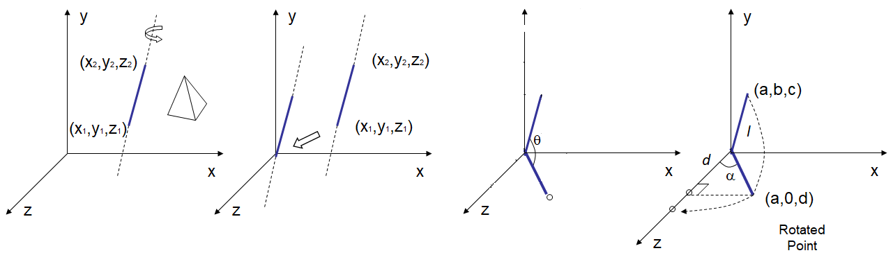
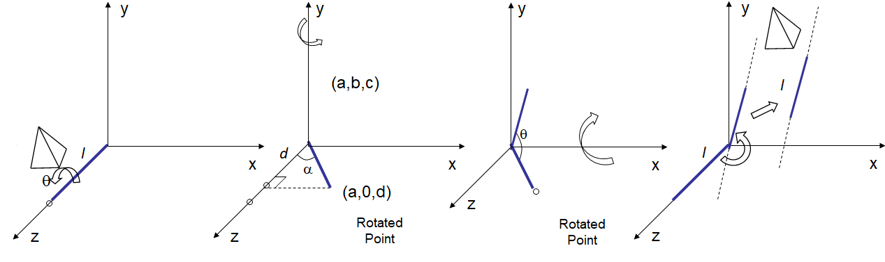
Rotation about an Arbitrary Axis
cm = T’_{(x1,y1,z1)} . R’_{X} . R’_{y} . R_{z} . R_{y} . R_{X} . T_{(-x1,-y1,-z1)}

Slide 4
Rotation about an Arbitrary Axis
Step 1
Translate (x₁, y₁, z₁) to the origin
y
(x2,y2,z2)
(x1,y1,z1)
x
z

Slide 5
Rotation about an Arbitrary Axis
Step 2
Rotate the line about x axis in anti clockwise direction by ‘θ’ angle
y
(0,b,c)
(a,b,c)
Projected Point
θ
θ
x
(a,0,?)
z
Rotated Point

Slide 6
Rotation about an Arbitrary Axis
Step 3
Rotate the line about y axis in clockwise direction by ‘α’ angle
y
Projected Point
d
l
α
x
(a,0,d)
Rotated Point
z

Slide 7
Rotation about an Arbitrary Axis
Step 4
Rotate the object about the line that has been aligned with z axis by the desired angle ‘φ’
y
l
x
z

Slide 8
Rotation about an Arbitrary Axis
Step 5
(apply reverse transformations to place the arbitrary axis along with the reflected object back to its original position)
Rotate the line about y axis in anti clockwise direction
y
d
α
x
(a,0,d)
Rotated Point
z

Slide 9
Rotation about an Arbitrary Axis
Step 6
Rotate the line about x axis in clockwise direction
y
θ
x
z
Rotated Point

Slide 10
Rotation about an Arbitrary Axis
Step 7
Rotate the line about y axis in clockwise direction
y
l
l
x
z

Slide 11
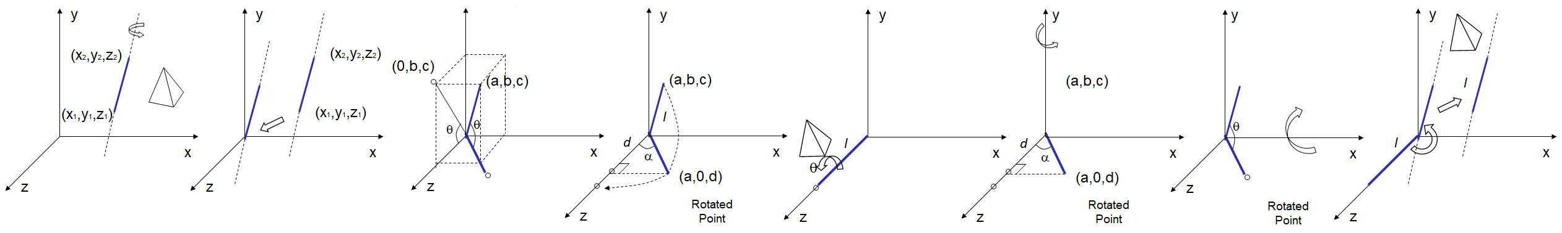
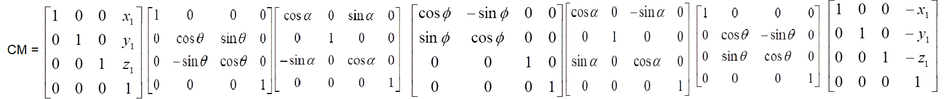
Rotation about an Arbitrary Axis
Cm= T’ . R’_{X} . R’_{Y} . R_{Z} . R_{Y} . R_{X} . T

Slide 12
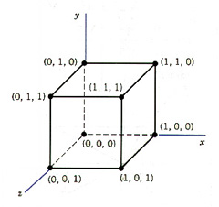
Rotation about an Arbitrary Axis
How will you rotate a unit cube 90º about an axis defined by its endpoints A(2,1,0) and B(3,3,1).
cm = T’_{(x1,y1,z1)} . R’_{X} . R’_{y} . R_{z} . R_{y} . R_{X} . T_{(-x1,-y1,-z1)}

Slide 13
How will you rotate a unit cube 90º about an axis defined by its endpoints A(2,1,0) and B(3,3,1).
Step 1
Translate end point A (2, 1, 0) to the origin
y
B(3,3,1)
B’(1,2,1).
A(2,1,0)
A’(0,0,0).
x
z

Slide 14
How will you rotate a unit cube 90º about an axis defined by its endpoints A(2,1,0) and B(3,3,1).
Step 2
Rotate the line about x axis in anti clockwise direction by ‘θ’ angle
y
(0,2,1)
(1,2,1)
Projected Point
θ
θ
x
(1,0,?)
z
Rotated Point

Slide 15



How will you rotate a unit cube 90º about an axis defined by its endpoints A(2,1,0) and B(3,3,1).
Step 3
Rotate the line about y axis in clockwise direction by ‘α’ angle
y
l = $√6$ d =$√5$
Projected Point
l =$√6$
d
α
x
(1,0, $√5$)
Rotated Point
z

Slide 16
How will you rotate a unit cube 90º about an axis defined by its endpoints A(2,1,0) and B(3,3,1).
Step 4
Rotate the object about the line that has been aligned with z axis by the desired angle ‘φ’
y
l
x
φ
z

Slide 17
How will you rotate a unit cube 90º about an axis defined by its endpoints A(2,1,0) and B(3,3,1).
Step 5
Rotate the line that has been aligned with z axis by the angle alpha angle in ccw along with the rotated object
y
l
x
z

Slide 18
How will you rotate a unit cube 90º about an axis defined by its endpoints A(2,1,0) and B(3,3,1).
Step 6
Rotate the line about x axis in cw
y
l
x
z

Slide 19
How will you rotate a unit cube 90º about an axis defined by its endpoints A(2,1,0) and B(3,3,1).
Step 7
Translate end point back to (2, 1, 0)
y
(3,3,1)
(2,1,0)
x
z

Slide 20
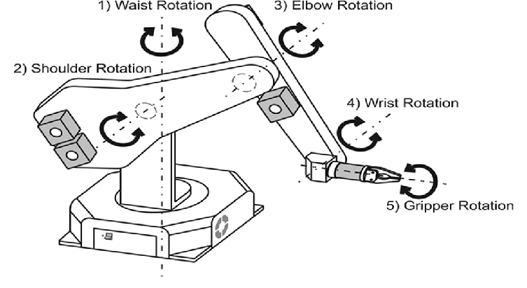
Rotation about an Arbitrary Axis
Cm= T’ . R’_{X} . R’_{Y} . R_{Z} . R_{Y} . R_{X} . T

Slide 21
Reflection about an Arbitrary Plane
Hints:
Spatial orientation of a plane in 3D space is given by its outward normal
Translate plane so that it passes thru origin
Rotate the Normal two times so that it gets aligned with z axis and the plane lands on xy plane
Take reflection of object about that plane
Perform inverse rotations and translation
z
z
x
x
y
y

Slide 22
Reflection about an Arbitrary Plane
Step 1
Translate the plane along with the object to be reflected about it so that the plane passes thru origin
z
x
y

Slide 23
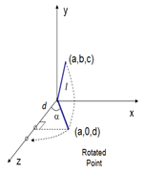
Reflection about an Arbitrary Plane
Step 2
Rotate the normal about x then y axis so that the normal is aligned with z axis and the plane is aligned with xy plane
z
x
y

Slide 24
Reflection about an Arbitrary Plane
Step 3
Reflect the object about the xy plane with which the plane has been aligned
z
x
y

Slide 25
Reflection about an Arbitrary Plane
Step 3
Reflect the object about the xy plane with which the plane has been aligned
z
x
y

Slide 26
Reflection about an Arbitrary Plane
Step 4
Rotate the normal about y then x axis so that the normal is de-aligned from z axis and the plane is de-aligned with xy plane
z
x
y

Slide 27
Reflection about an Arbitrary Plane
Step 5
Translate the plane along with the reflected object back to its original location
z
x
y

Slide 28
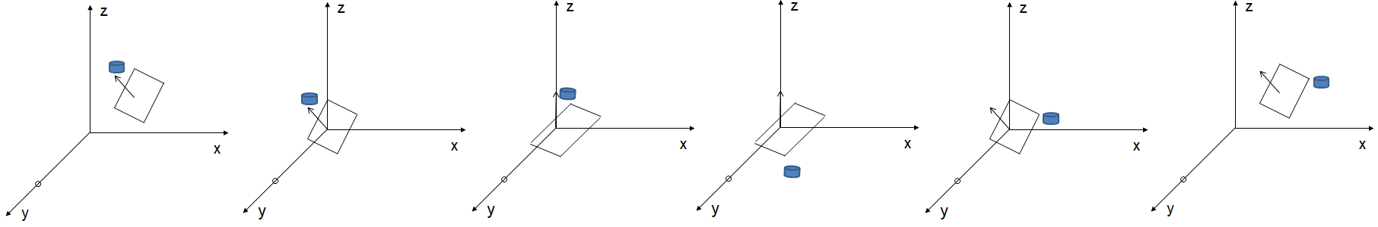
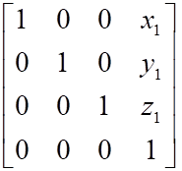
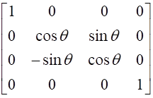
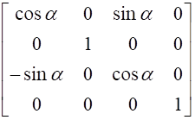
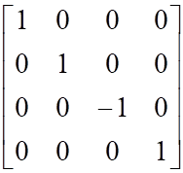
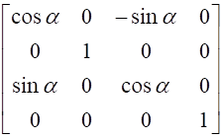
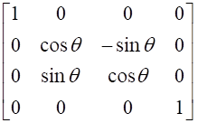
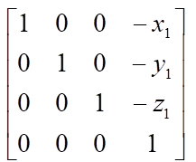
Reflection about an Arbitrary Plane
CM=

